Slide 1
VerifAI
Team Sleepyyy
TEAM MEMBERS: Archit Kumar Sahoo, Omkar Narayan Mishra, Moksha Singh

Slide 2
Team Sleepyyy
The Problem
KYC Verification at Scale is Inefficient and Unreliable
Current systems struggle with the sheer volume and complexity of document processing in India.
India processes millions of KYC verifications annually across banking, insurance, and fintech sectors.
Existing systems rely on manual review and basic OCR-based tools, which lack modern intelligence.
Key Limitations
No reasoning capability
Systems cannot interpret context, variations, or inconsistencies.
High false rejection rate (20–30%)
Valid applications are rejected due to rigid rule matching.
Lack of explainability
Decisions provide no audit trail or justification for outcomes.
Inadequate fraud detection
Tampered or edited documents often go undetected by basic tools.

Slide 3
Team sleepyyy
The Solution: VerifAI
An AI-Powered KYC Verification Agent
VerifAI introduces an agent-based approach to document verification that goes beyond extraction and enables reasoning, validation, and explainability.
Structured Extraction
Uses Vision-Language Models to extract key fields with confidence scores
Tamper Detection
Detects edited documents using Error Level Analysis (ELA) and EXIF metadata
Cross-Verification
Performs semantic matching across documents to identify inconsistencies
Automated Compliance
Applies RBI KYC and AML rules through an auditable rule engine
Explainable Decisions
Generates clear, human-readable justifications for every outcome
Outcome: Reliable, Transparent, and Automated KYC Processing

Slide 4
Team Sleepyyy
April 2026
Identity Verification Pipeline
INPUT DOCUMENTS
Aadhaar | PAN | Utility Bill
PREPROCESSING
Base64 Encoding
UNIFIED PROMPT
GPT-4o Vision Processing
EXTRACTION
Structured JSON Output
MAPPING
LLM Reasoning & Validation
FINAL OUTPUT (DECISION)
✔ Match / ✖ Mismatch / ⚠ Escalate
Confidence Score + Automated Narrative Explanation
CONTEXTUAL LOGIC
Consistency Checks
FUZZY MATCHING
Typo Resilience Scoring
Automated Forensic Workflow for Multi-Document Verification

Slide 5

Team sleepyyy
Modular Architecture for Absolute Integrity
STAGE 1
ELA
Detecting digital tampering.
STAGE 2
AI Multimodal Extraction
Unified vision processing.
STAGE 3
Identity Mapping
Resolving name variations & typos.
STAGE 4
Compliance Engine
Regional rule validation (Regex/Freshness).
STAGE 5
Risk Analysis
Synthetic detection & PEP/AML scanning.
STAGE 6
Executive Summary
Automated forensic narration.
Securing Verification with Intelligent Modular Stages

Slide 6
Team Sleepyyy
Year/Quarter/Month
GPT-4o Cross-Document Intelligence
UNIFIED PROMPTING
Multi-Document Vision Context
Aadhaar, PAN, and Utility Bills processed simultaneously in a single vision context for holistic analysis.
BEYOND OCR
Cross-Document Mapping
The AI evaluates deep semantic relationships between different documents to detect structural inconsistencies.
TYPO RESILIENCE
Intelligent Fuzzy Matching
Sophisticated matching allows for realistic spelling variations while maintaining strict security and integrity.
CONTEXTUAL LOGIC
Real-Time Address Verification
Verifying addresses on utility bills against primary identity documents using real-time reasoning loops.

Slide 7
Team Sleepyyy
HOW WE OVERCAME THEM
SOLUTION 01
Document Variability
Used Vision-Language Models for flexible extraction
Schema-based output ensures consistency
SOLUTION 02
Fraud Detection
Implemented ELA + EXIF checks
Tampering detected before processing
SOLUTION 03
False Positives
Semantic matching (RapidFuzz)
Confidence thresholds + escalation
SOLUTION 04
Explainability
Multi-stage pipeline with reasoning trace
Human-readable justifications
SOLUTION 05
System Scaling
Event-driven (RabbitMQ/Redis)
Parallel efficient processing

Slide 8
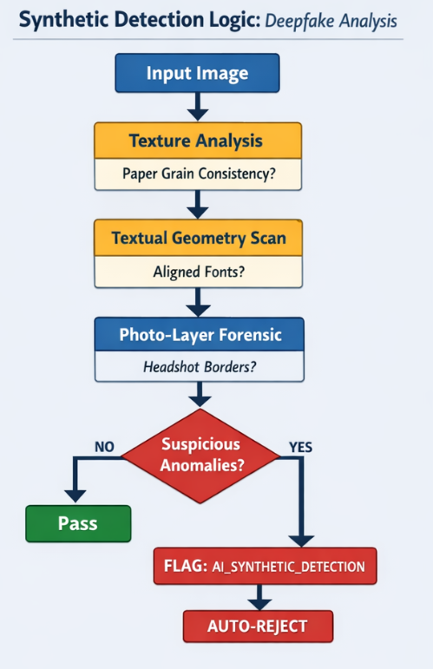
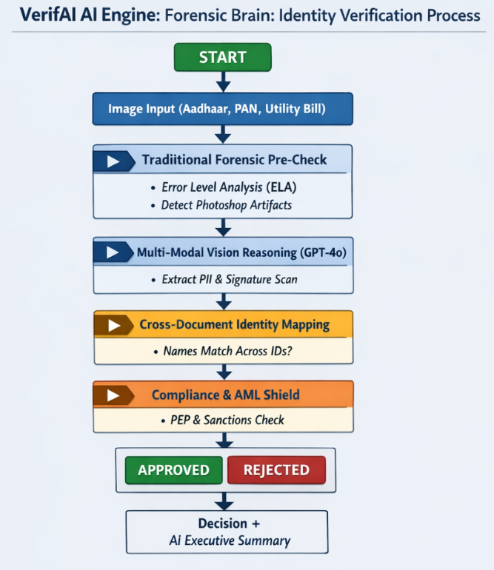

Slide 9
Year/Quarter/Month
Measuring the Success of VerifAI
01. ACCURACY & DECISION
Decision Quality
False rejection rate <10%
High AI vs ground truth alignment
Approve / Escalate / Reject balance
02. FRAUD DETECTION
Performance Metrics
Tampering detection (ELA accuracy)
Stage 1 effectiveness
Reduced fraud leakage
03. OPERATIONAL EFFICIENCY
Speed & Automation
Verification <10 seconds
70–80% manual work reduction
Faster onboarding pipeline
04. COMPLIANCE
Explainability
100% reasoning trace
Clear rule-level justifications
Audit-ready regulatory outputs
05. SYSTEM PERFORMANCE
Scalability
Concurrent request handling
Stable latency under load
Fault-tolerant architecture
Success is building a system that is reliable, explainable, and scalable in real-world conditions.

Slide 10
Thank you

